Slide 1
Transfer Learning
Powerful usage of Transfer Learning model to solve FoodVision101 classification problem

Slide 2


About me
My name is Mark Chernomorchenko. I study Artificial Intelligence and I solve Machine Learning problems such as regression, classification, object detection using Deep Learning and Neural Networks. In the future I would like to learn how to create Neural Networks for Natural Language Processing, object segmentation problem and so on.

Slide 3
Chapter 0: Problems of CNN
In this module I will explain you what is Transfer Learning and how it works

Slide 4


Slide 5
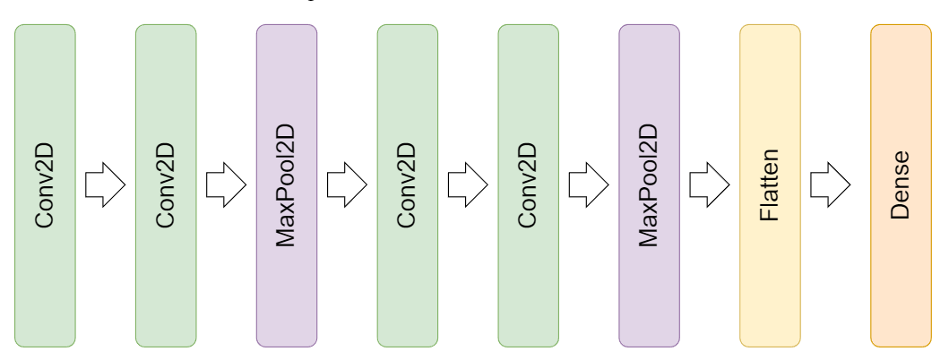

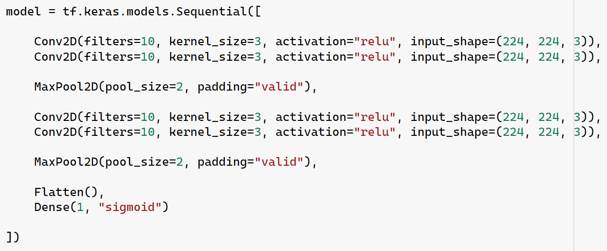
Tiny VGG architecture

Slide 6
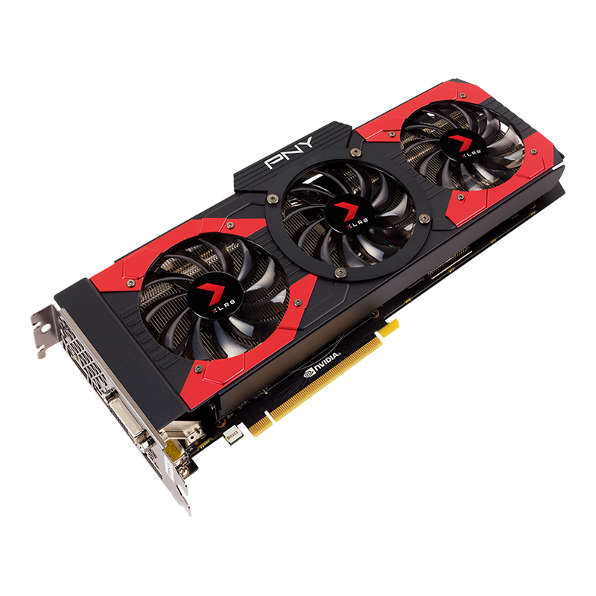
Issues
Time. We need a lot of time to train a CNN model from scratch.
Data. We also need a really huge DataSet!
Computing Ability. It is better to have powerful computing possibilities.

Slide 7
Chapter 1: Transfer Learning
In this module I will explain you what is Transfer Learning and how it works

Slide 8
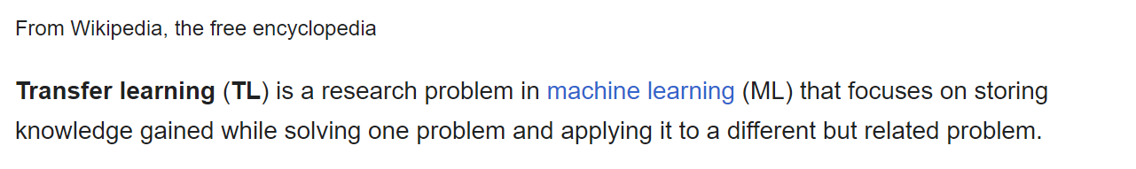
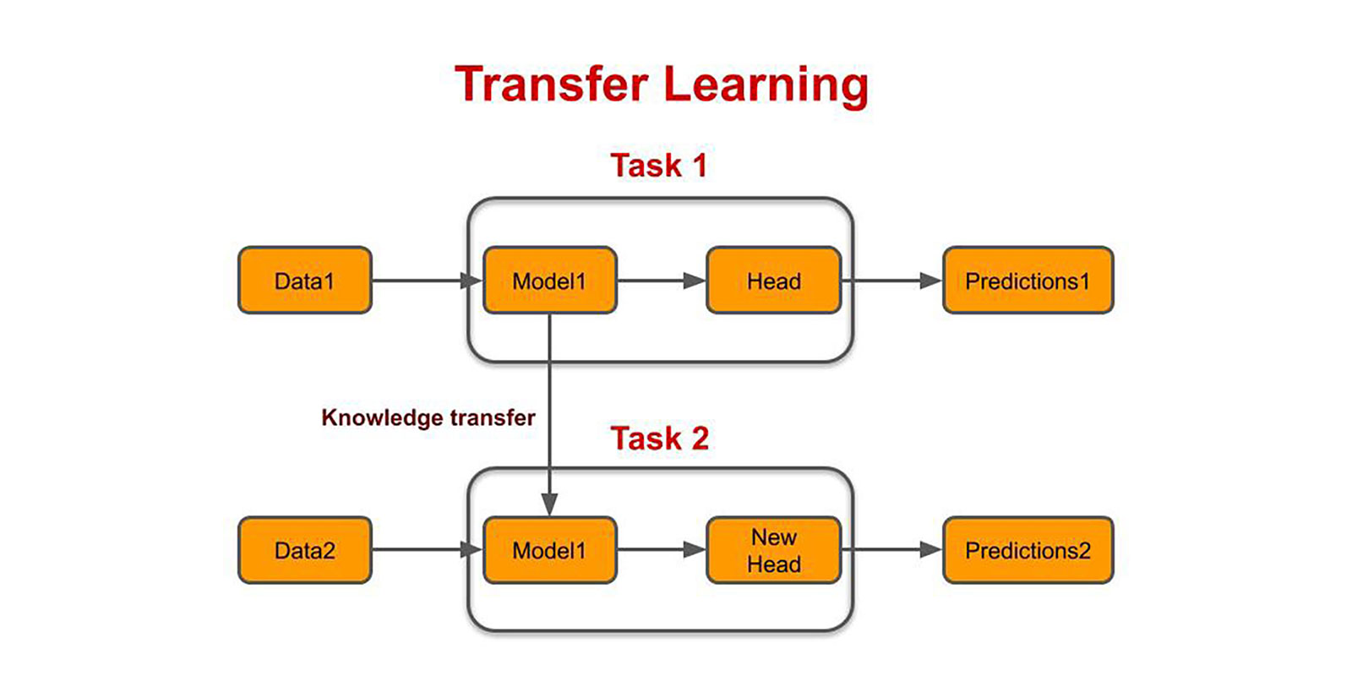

Slide 9
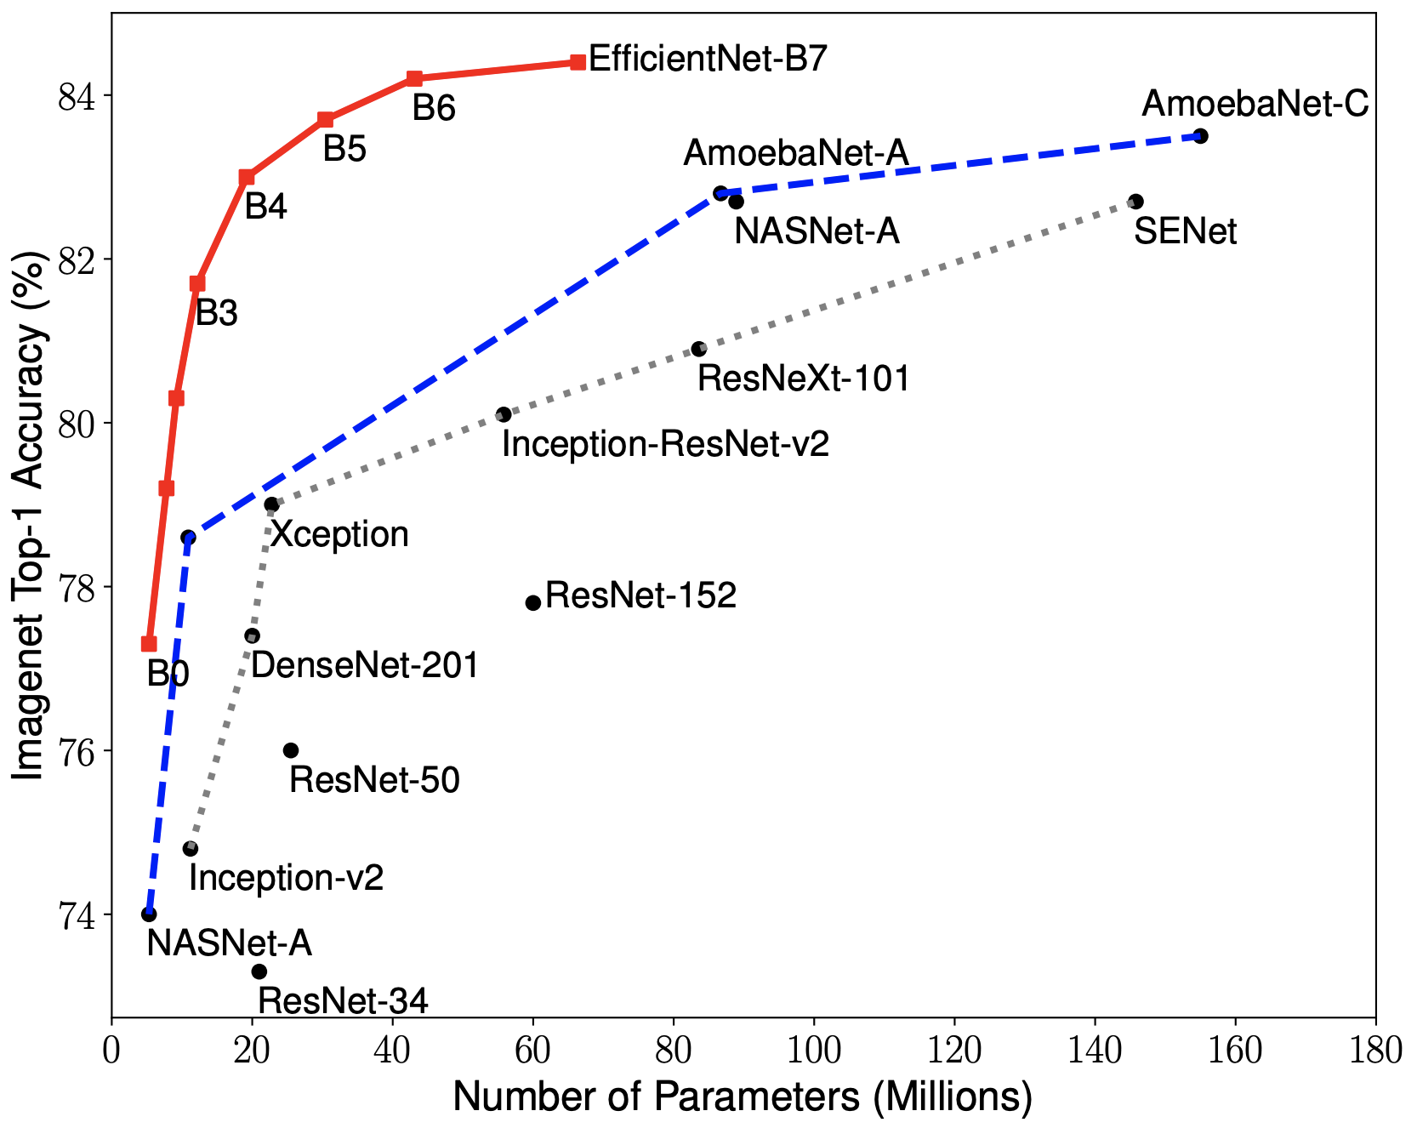

Slide 10

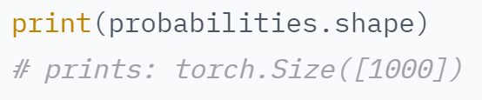
EfficientNet model (EfficientNetB0)

Slide 11
How to create a model using EfficientNetB0?
Step 1: Download our TL model from TensorFlow Hub
Step 2: Freeze our model (prevent our model change its weights while it has been trained)
Step 3: Add other layers to our model if needed
Step 4: Add our transfer learning model to our
Step 5: Add layers after TL model if needed
Step 6: We definitely need a Dense layer with activation function!

Slide 12
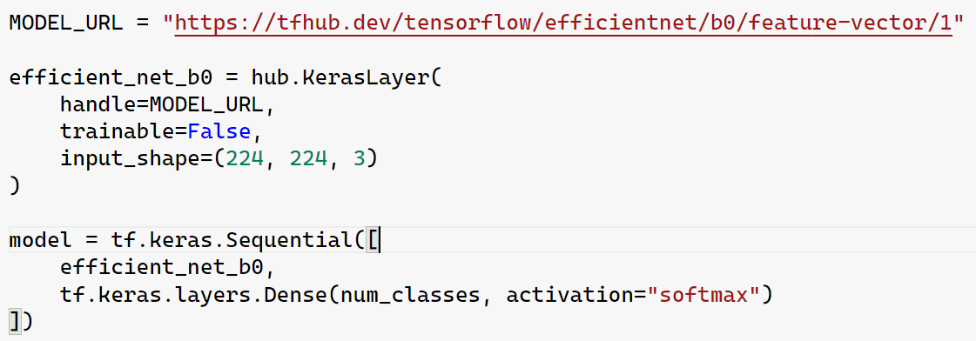
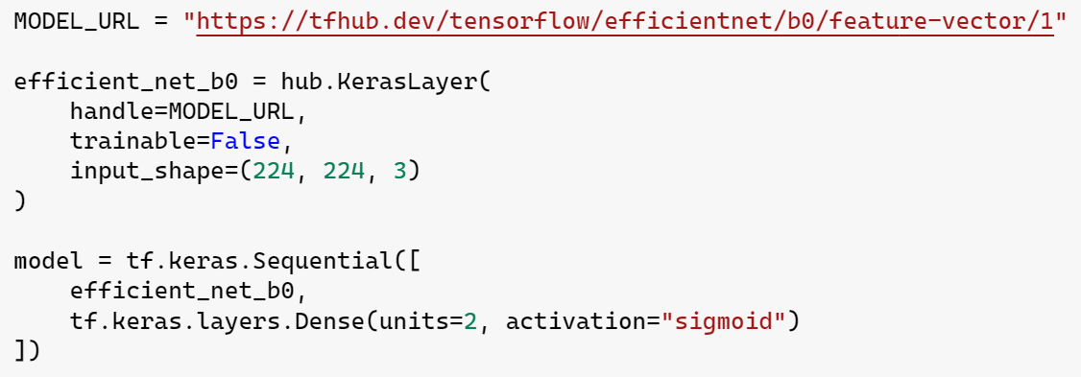

Slide 13
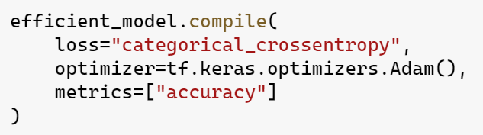
Creating CNN model based on EfficientNetB0: Compilation

Slide 14

Loss Function? Categorical Cross Entropy? Optimizer? Adam? Accuracy?

Slide 15
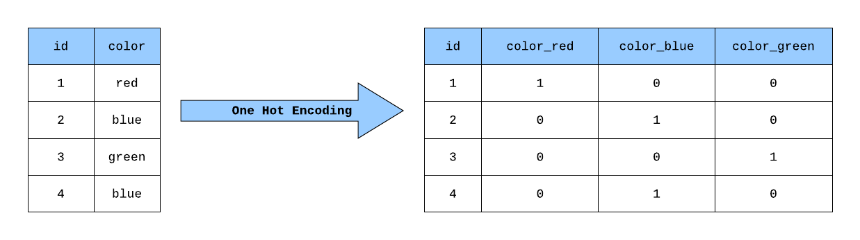
Categorical Cross Entropy. One-Hot encoding:

Slide 16
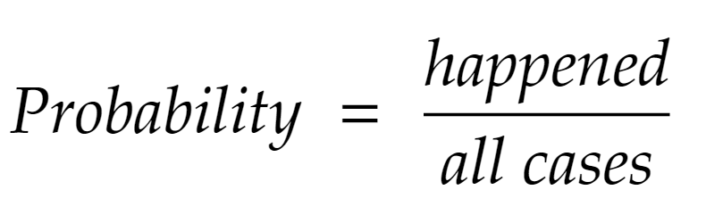
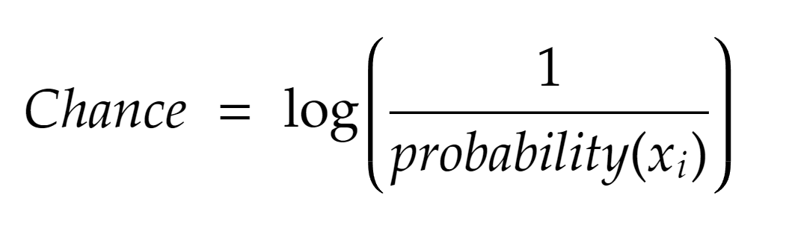
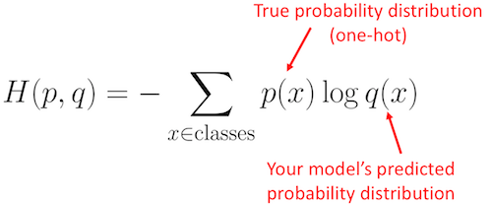
Categorical Cross Entropy

Slide 17
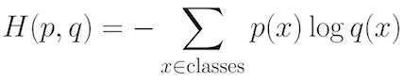
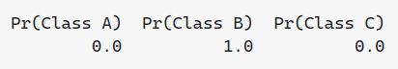
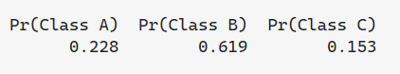

Slide 18
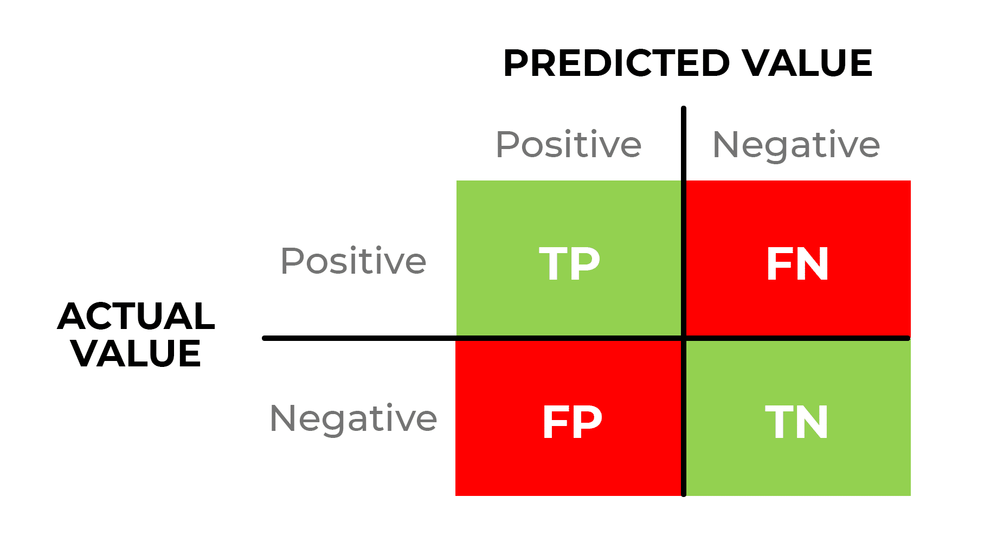
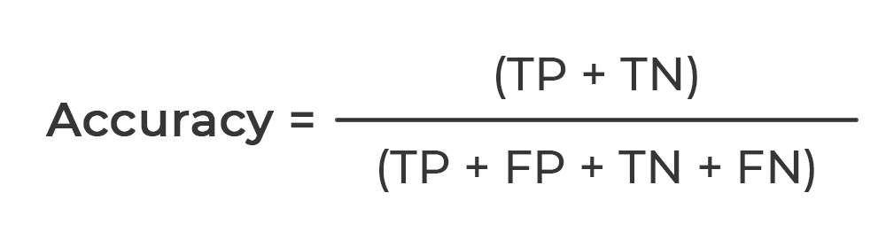
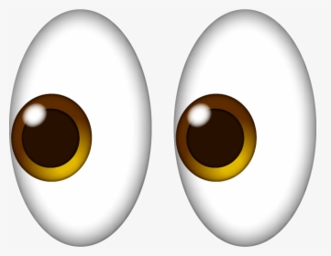
Accuracy

Slide 19
Chapter 2: Prepare our model
In this module I will explain what strategies I used to train my model

Slide 20
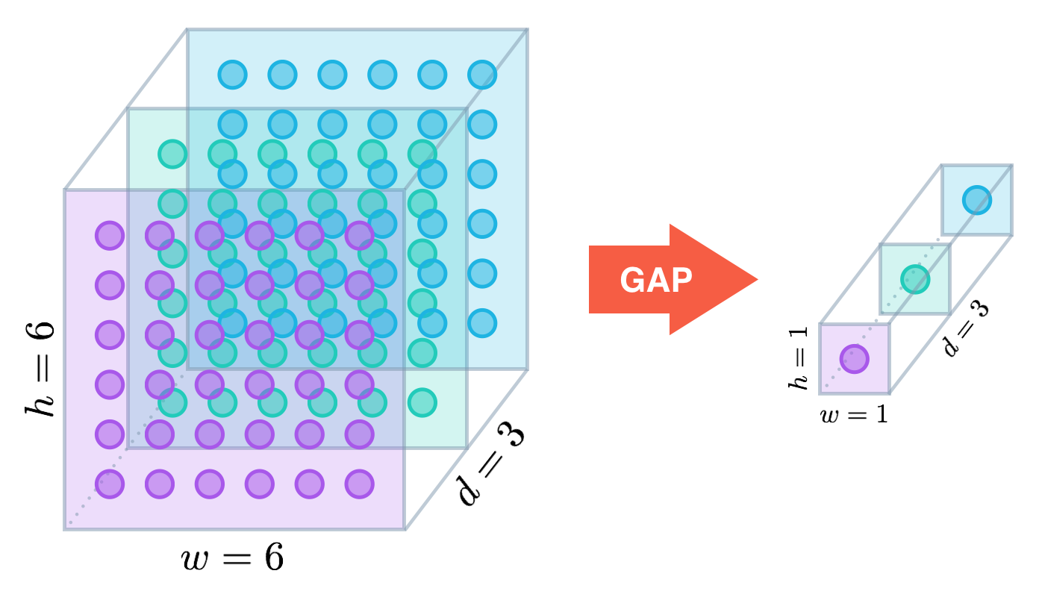
Step 1: Feature Extraction. GlobalAveragePooling Layer
Input
EfficientNet
Feature Extraction Layer
Output

Slide 21
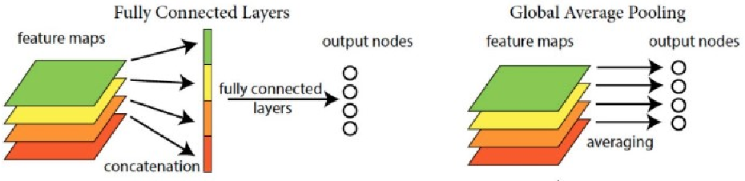
In the last few years, experts have turned to global average pooling (GAP) layers to minimize overfitting by reducing the total number of parameters in the model. Similar to max pooling layers, GAP layers are used to reduce the spatial dimensions of a three-dimensional tensor.

Slide 22
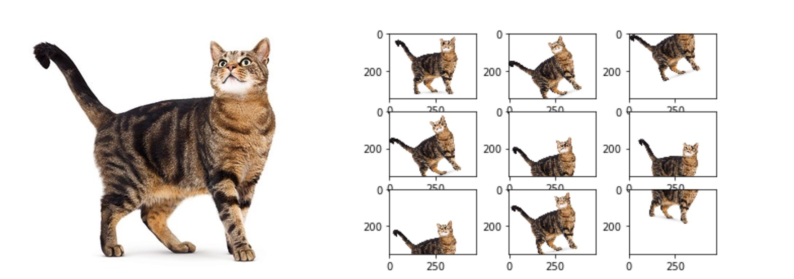
Step 2: Data Augmentation Layer

Slide 23
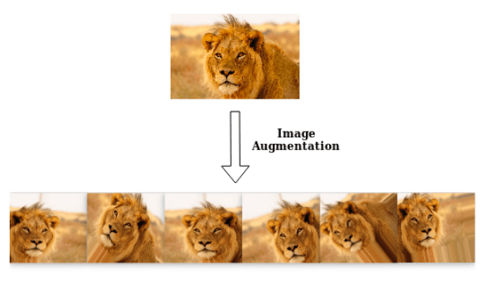

Slide 24
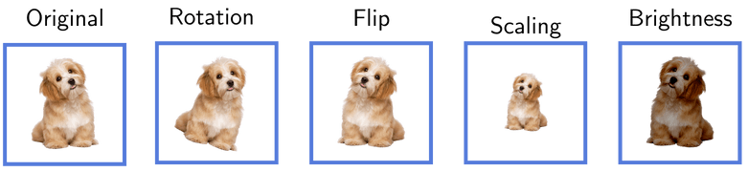

Slide 25
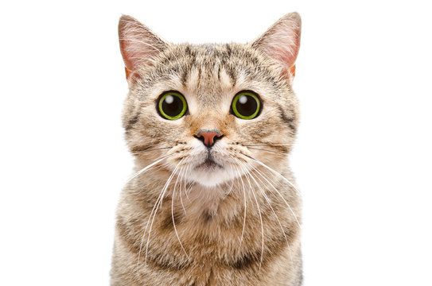
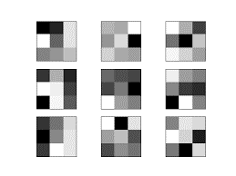
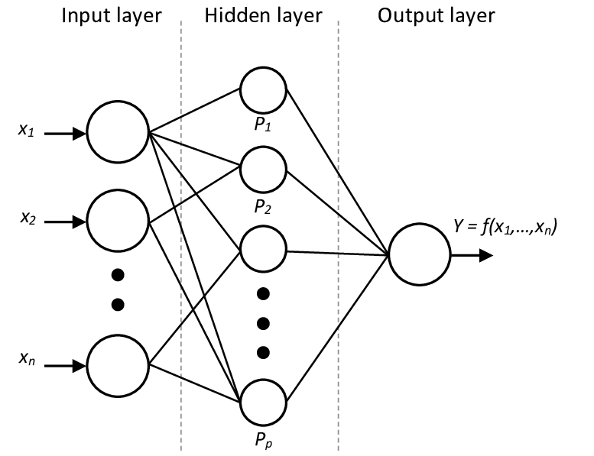

Input Layer
(Decode our image)
Data Augmentation
EfficientNetB0
Global Average Pooling
Fully Connected Layer
(Dense layer)
Output Layer

Slide 26
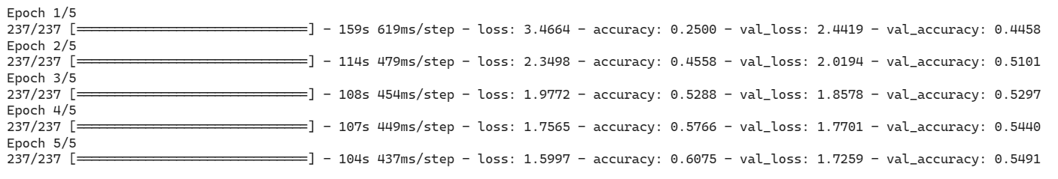
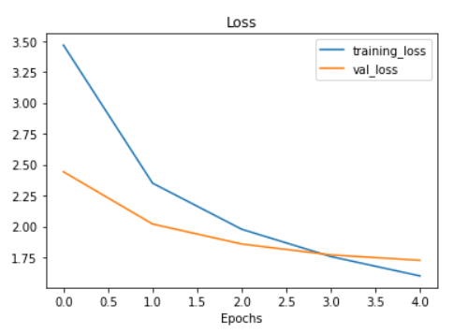
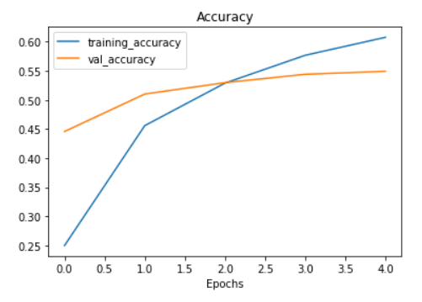

Slide 27
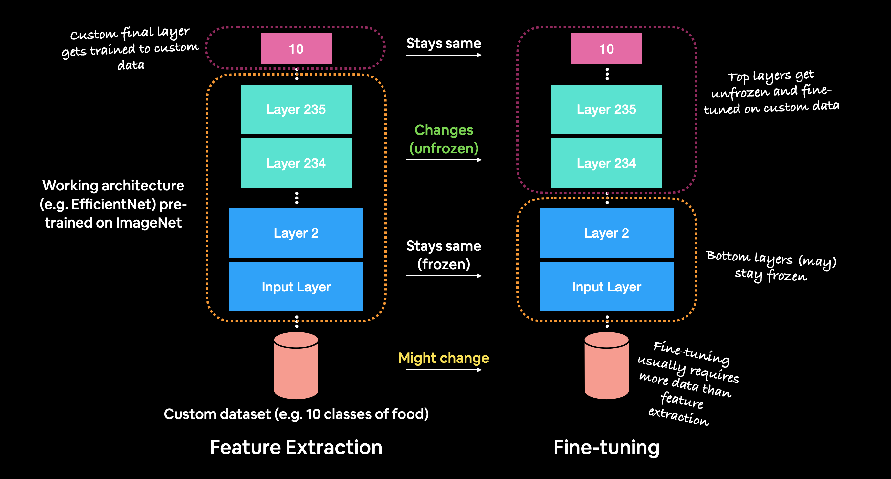
Step 3: Fine Tuning

Slide 28
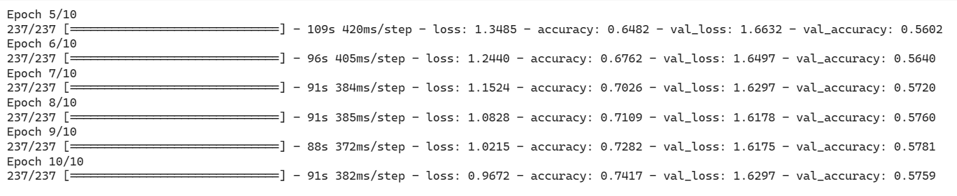

Slide 29
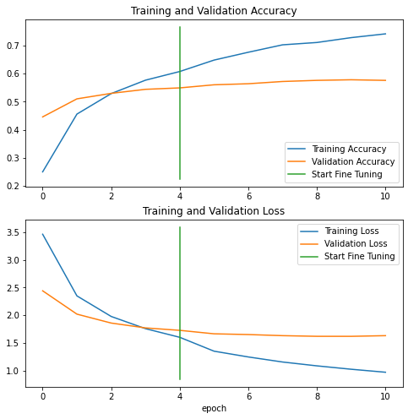
Step 4: Evaluate our model

Slide 30
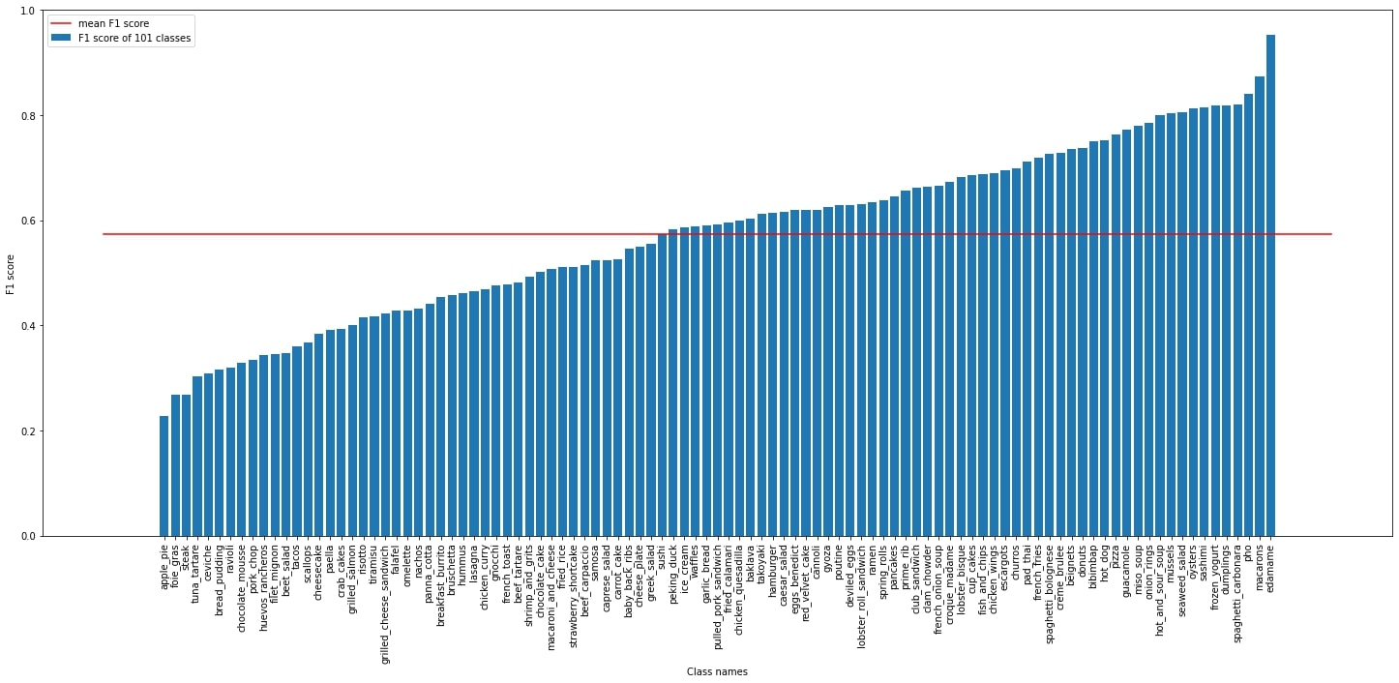

Slide 31
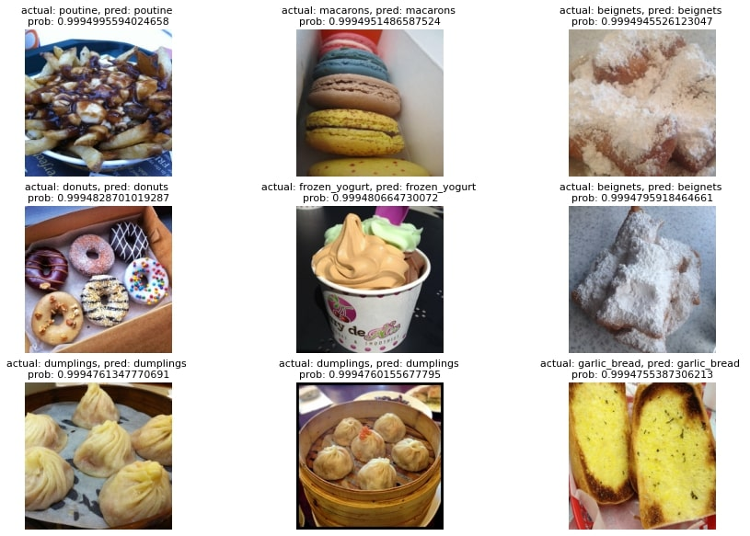
Correct predictions

Slide 32
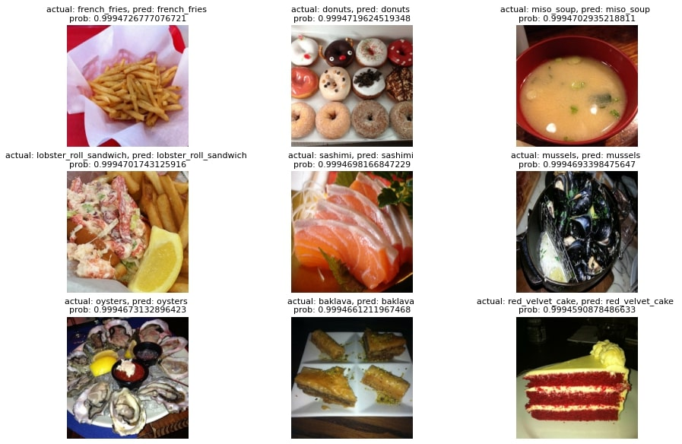

Slide 33
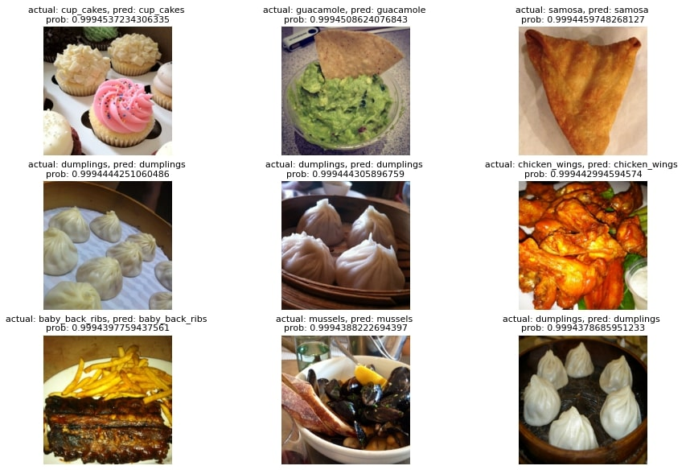

Slide 34
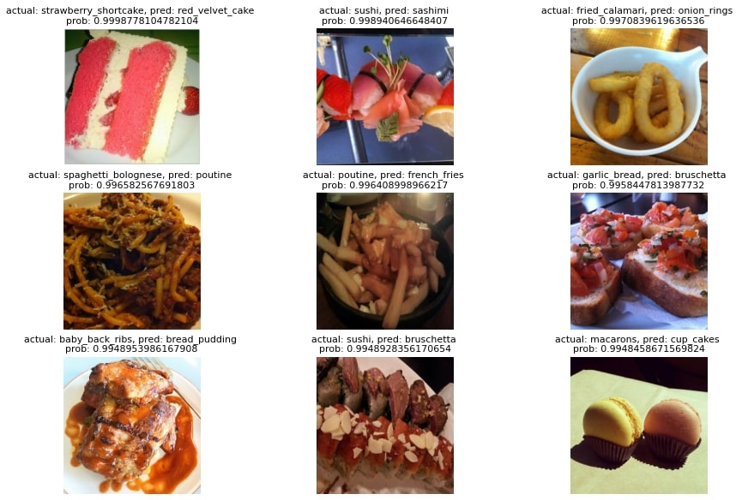
Wrong predictions

Slide 35
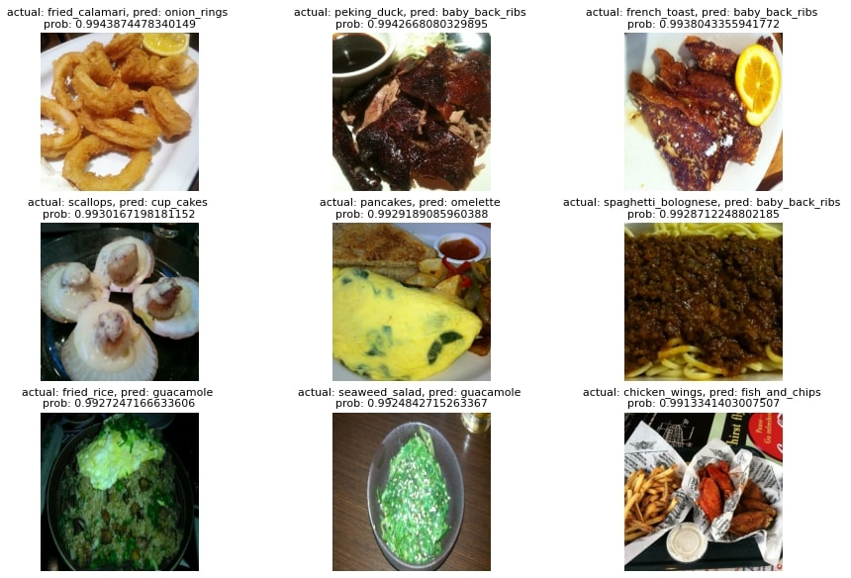

Slide 36
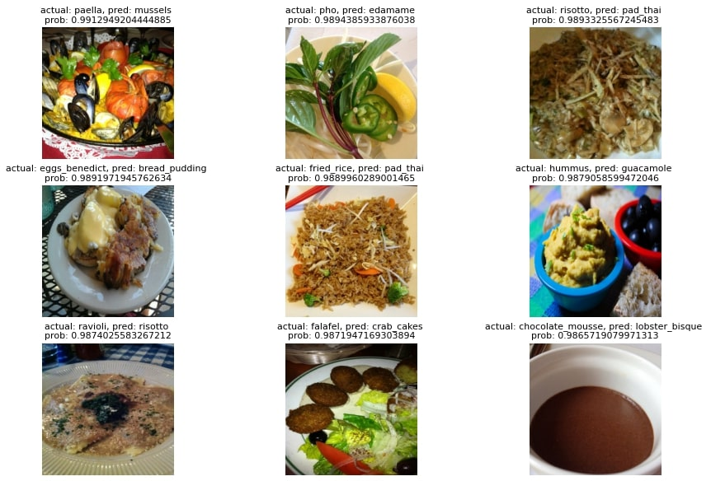

Slide 37
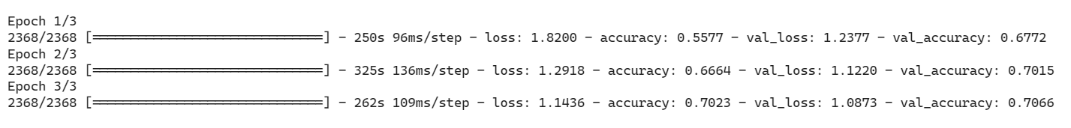
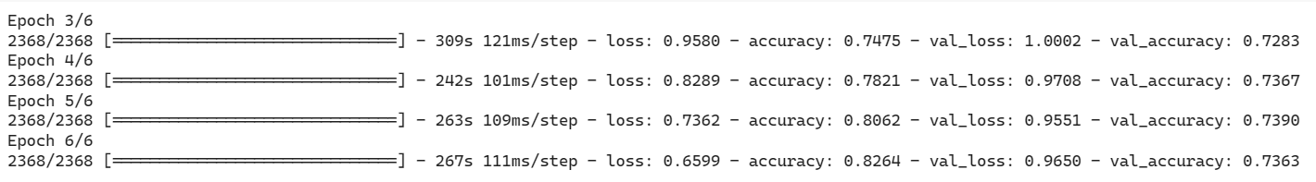
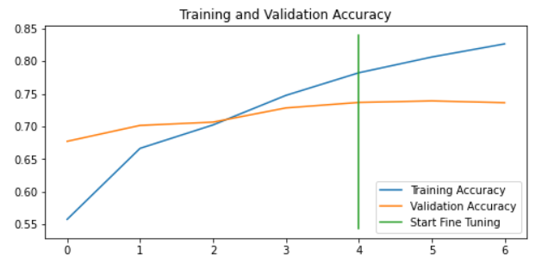
UPD: EfficientNetB0 model with 100% of data in usage. Mixed precision as a powerful booster

Slide 38
Thank You!

